Slide 1
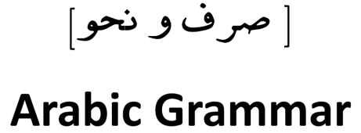
قواعد اللغة العربية
Enamul Hamid Shibly
ehamid70@yahoo.com
469-583-0879

Slide 2
What this class is -
NOT Learning Arabic from alphabet
NOT to Fix “makhraj” and recitations, but word sensitivity will increase.
Without reading and writing Arabic will make the learning difficult – after all it is a language class.
NOT Just a class to attend so that one can get hasana
Will not help learning if students think
    Its a free class, I will have more chances… I will attend Bayyinah etc
    The teacher is an engineer, not sure if delivery of good instruction possible
    Just to hoard class notes intending to study at a future dates – may not happen
It is not a “lecture-only” session – so keep the “radio-on” and mind my other business
Not a Spoken Arabic class or be able to read any arbitrary Arabic books

Slide 3
What is the goal of this class
Learn enough Arabic Grammar so that one can critically read and understand the Ayahs of the Quran – just a superficial translation does not do much!!
Need to follow the class and take notes. Class notes are the best books -> also make your custom “cheat sheet”
If we scope our learning to only the Quran, vocabulary requirements reduces by 80% at least!!
Learn some web based tools that help search ayahs and understand the grammar of the text.
It will improve the Quran recitation.

Slide 4
There are two options to our course
1. The conventional long route
2. Learn the Arabic that we use in our everyday prayers.
  Azan
  Duas in the prayer – Sana, Ruku’,Sujud, tashahhud, darud, duas etc
  Suras – Fatiha, Asr, Nasr and four Quls.

Slide 5
The Syllabus
BASIC & INTERMEDIATE
  Arabic 101 – Arabic 104
    Around 10-12 lectures per course
ADVANCED
  Around 10-12 lectures
  AROUND 1 YEAR COMMITTMENT

Slide 6
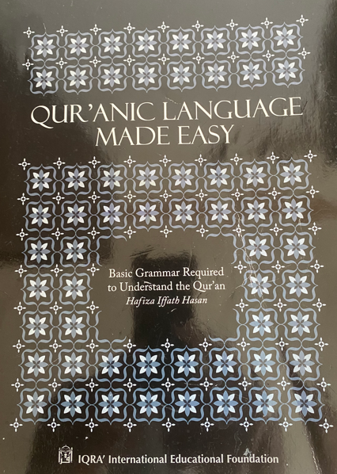
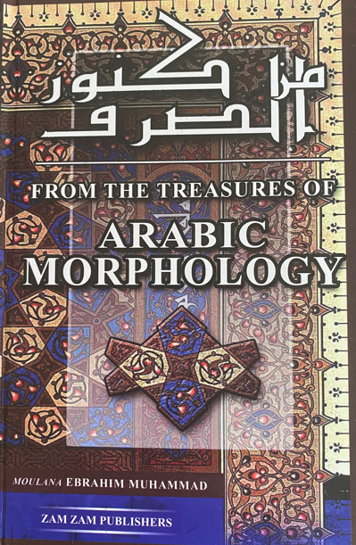
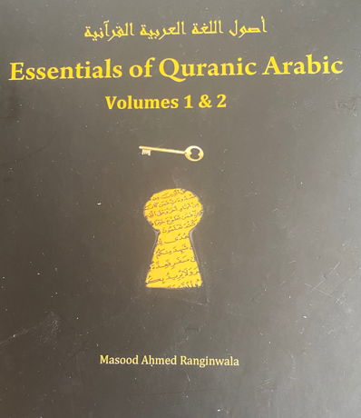
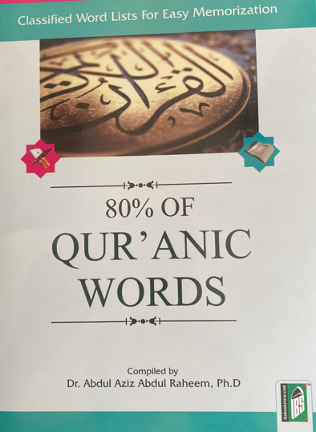
REFERENCE BOOKS

Slide 7
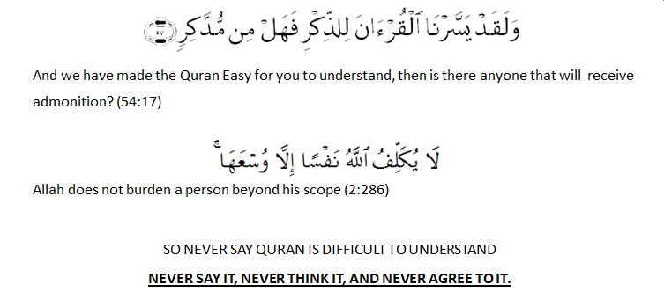

Understanding the Quran is Compulsory

Slide 8
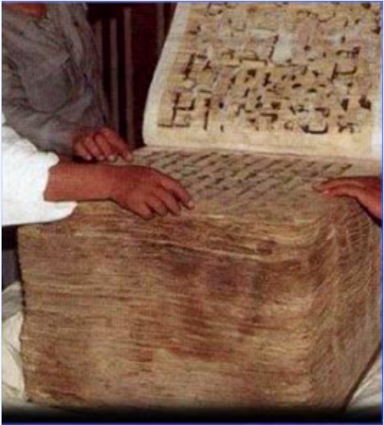
The Primitive form of Quran

Slide 9
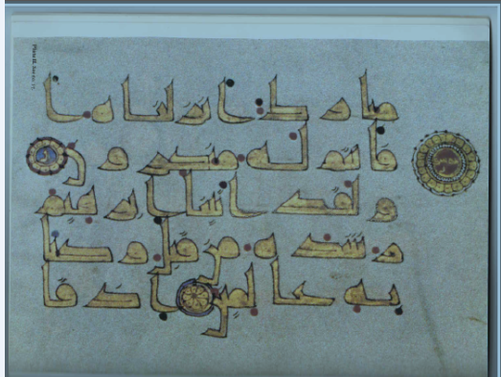
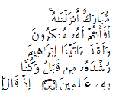

An Old Quranic Script
The revelation was in oral form.
The texts may not look like machine printed consistent spelling
Reading also has variants

Slide 10

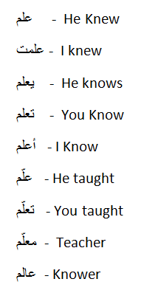
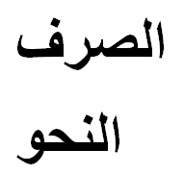
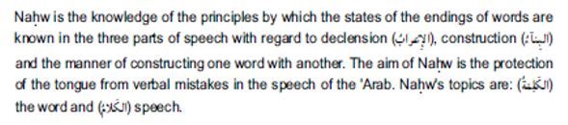
Arabic Grammar
Has two major sections
اللهُ اَكبرُ
انَّ اللهَ
وَللهِ

Slide 11
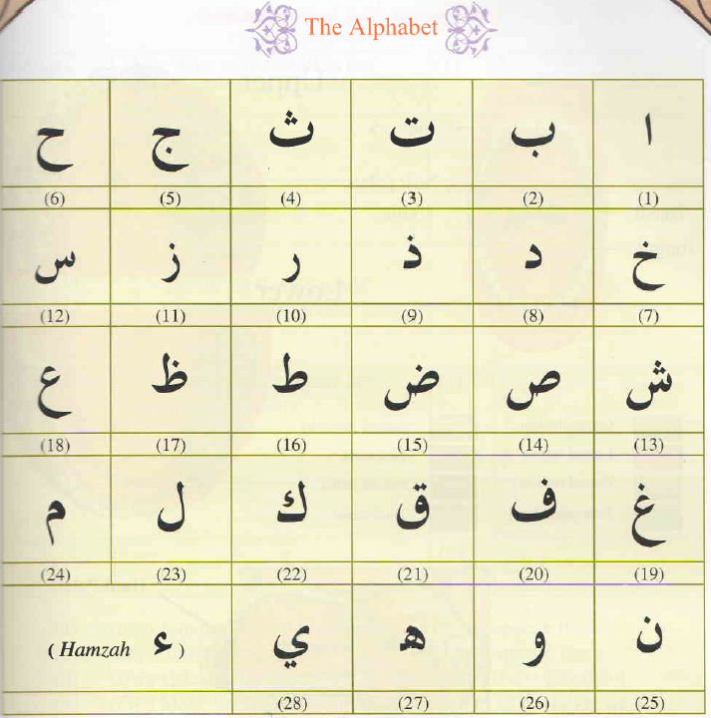
The Arabic Alphabet

Slide 12
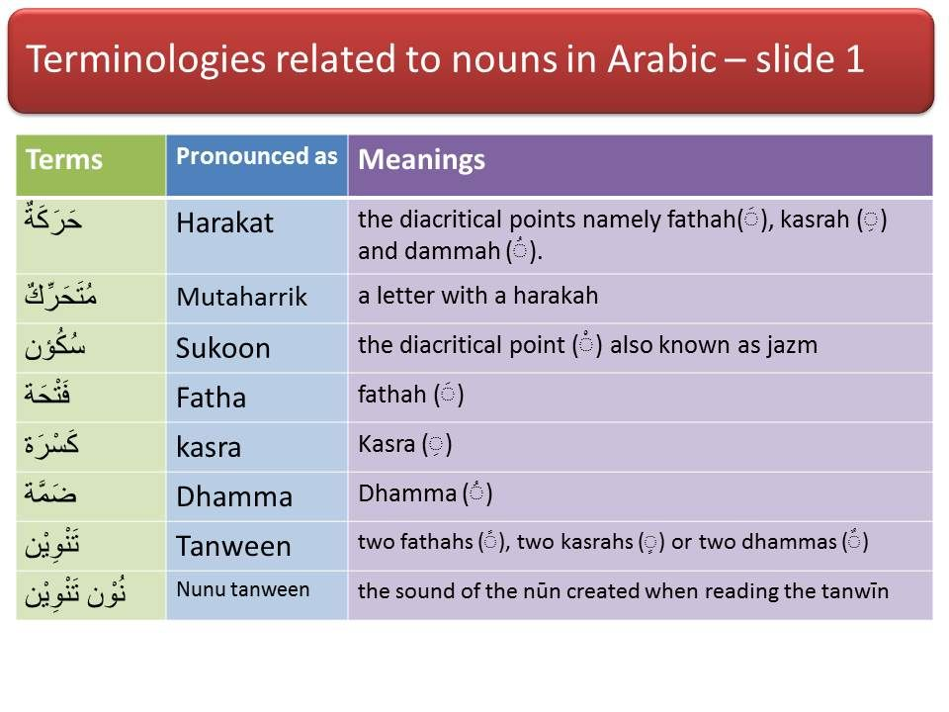
Tashkeel
تشكيل

Slide 13

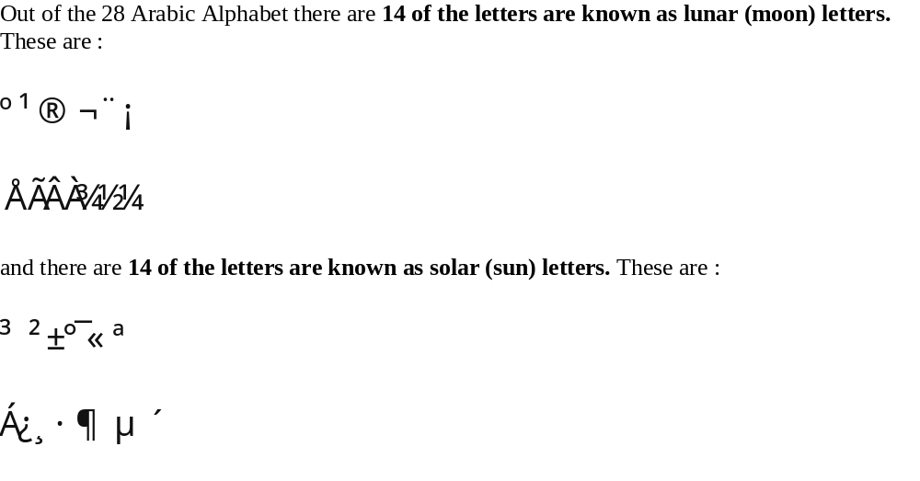
Sun and Moon Letters
These letters pronounced at or near the same point of articulation of “lam” itself

Slide 14
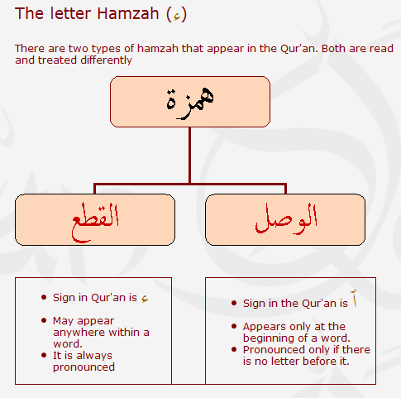
Hamza Types

Slide 15
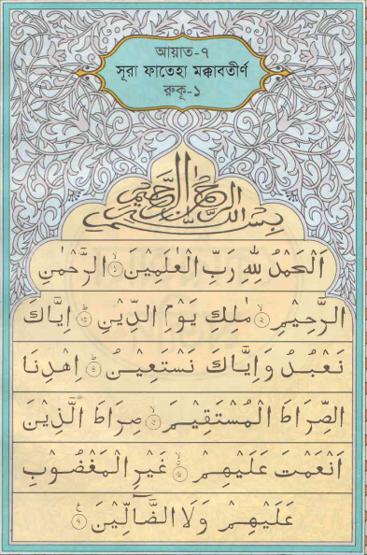
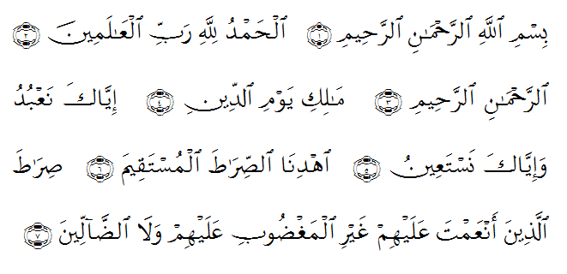
Comparing - همزة الوصل / همزة القطع

Slide 16
Comparing Arabic and English Parts of Speech
(أقسَامُ الكَلاَمِ)
اسم
Noun
Noun, Pronoun, Adjective, Adverb, Interjection
فعل
Verb
Verb
حرف
Letters
Preposition, Conjunctions

Slide 17
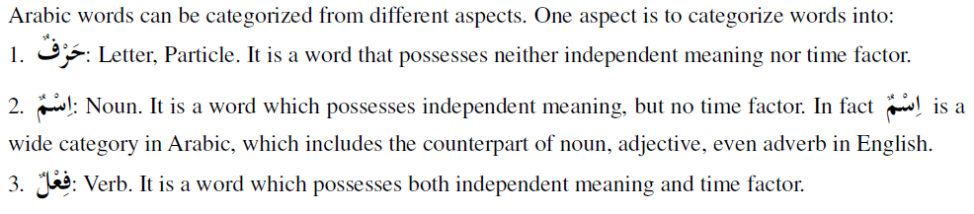
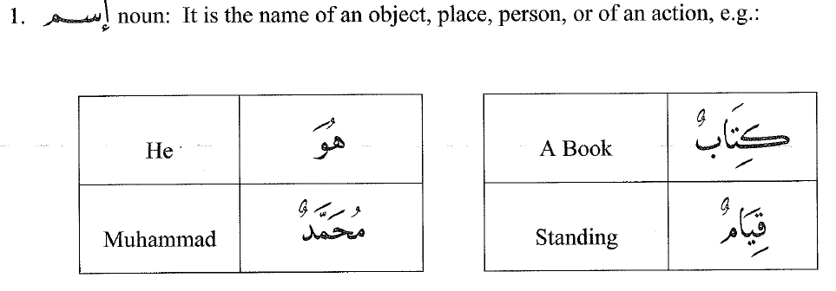
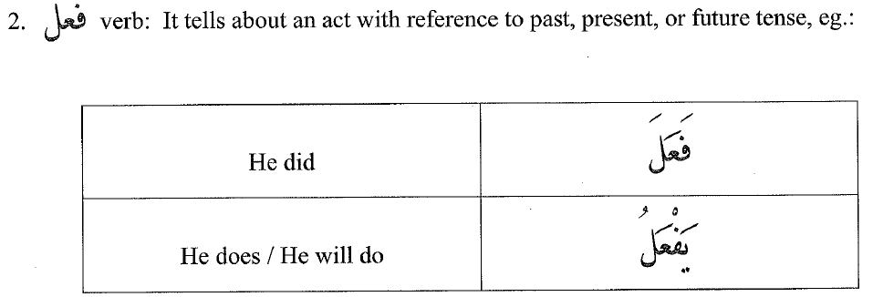
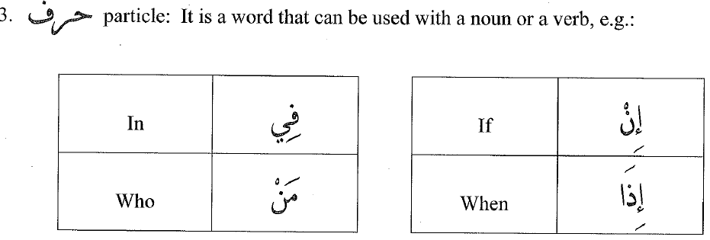
Word (كَلِمَة) Types
Letter is not really a letter always!

Slide 18

Signs of Nouns
Can have a definite article –al
Can end with a kasra
Can be called on/upon
Can end with tanween
Can end with taa marbutah

Slide 19

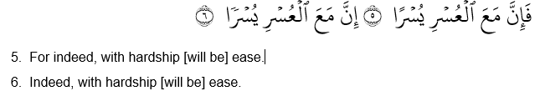
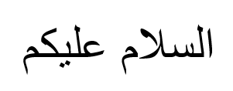
Definite and Indefinite Nouns

Slide 20
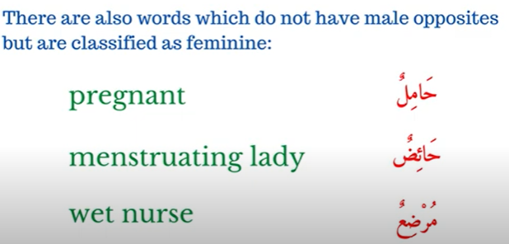
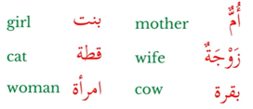


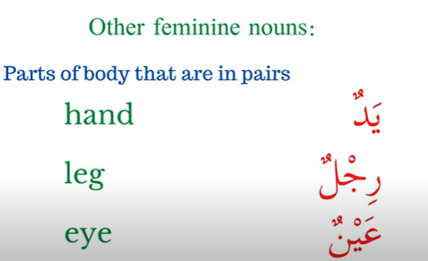
Gender (جِنسٌ) Types
Masculine (مُذَكَّر) what is not feminine ما ليس بمؤنث
Feminine (مُؤَنَّث)
  Biological / Real (حَقِقي)
  Non Biological (غير حققي)
    Some Formats(قِياسي)
    Conventional (سماعي)
      Some Rule
      No Rule – Arab Said So!!!

Slide 21
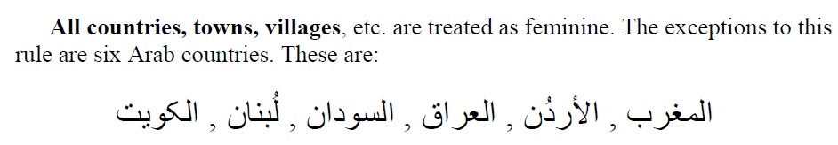
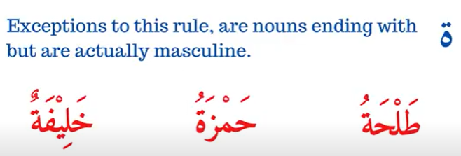
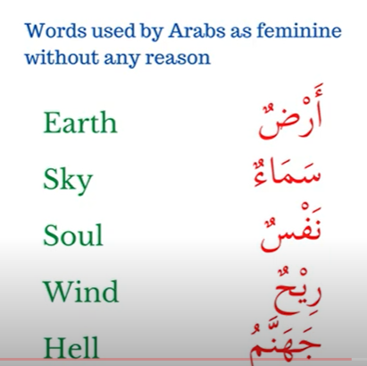
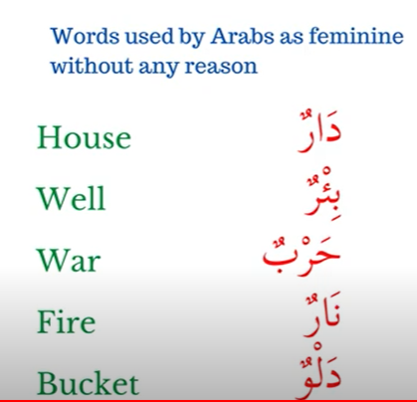
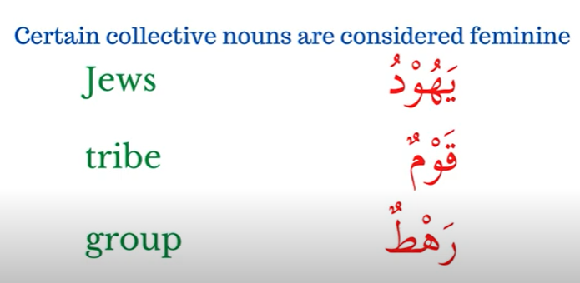
More Feminine Nouns (سماعى Conventional)
ARABS SAID SO

Slide 22
Making Feminine Gender t the end
Add ة t the end
Feminine | Noun
مُسْلِمة | مُسْلِم
مُؤْمِنة | مُؤْمِن
صَادِقة | صَادِق
كَاذِبة | كَاذِب

Slide 23
Numbers (العَدَدُ)
Singular (مُفرَدٌ)
Dual (مُثَنَّى)
Plural (جَمعٌ)
Plural | Dual | Singular | Gender
مُسلِمُونَ مُسلِمِينَ | مُسلِمَانِ مُسلِمَينِ | مُسلِمٌ | Masc
مُسلِمَاتٌ | مُسلِمَتانِ مُسلِمَتَينِ | مُسلِمَةٌ | Fem

Slide 24
Sound Plurals
Making Sound Feminine Plurals–Add ات at the end
Making Sound Masculine Plurals–Add ون، ين at the end
Feminine - Plural | Noun
مُسْلِمات | مُسْلِم
مُؤْمِنات | مُؤْمِن
صَادِقات | صَادِق
كَاذِبات | كَاذِب
Result | Single
مُسْلِمُون، مُسْلِمِين | مُسْلِم
مُؤْمِنُون، مُؤْمِنِين | مُؤْمِن
صَادِقون ، صَادِقين | صَادِق
كَاذِبون ، كَاذِبين | كَاذِب
كَافِرُون، كَافِرين | كَافِر
مُشْرِكُون، مُشْرِكِين | مُشْرِك

Slide 25
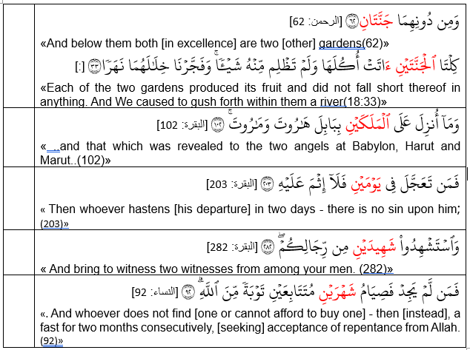
Duals in the Quran

Slide 26
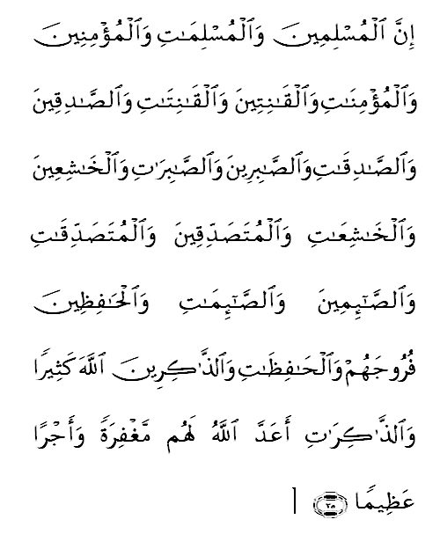
33:35 (Example Plurals –M/F)
Muslims , believers, obedient, truthful, patient, humble, Sadaqa-giver, Observe-Fast, Guard chastity, Remember of Allah – Allah has prepared for them Forgiveness and a great reward

Slide 27
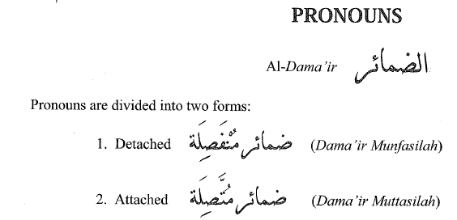
The pronoun
In English
In Arabic
I gave her my pen.
I => subject pronoun (He, she, it, they)
Her => object pronoun (me, him, her)
My => possessive pronoun (my, his)
Attached Pronoun
Detached Pronoun (separate, not attached to any word, works as a subject pronoun)

Slide 28
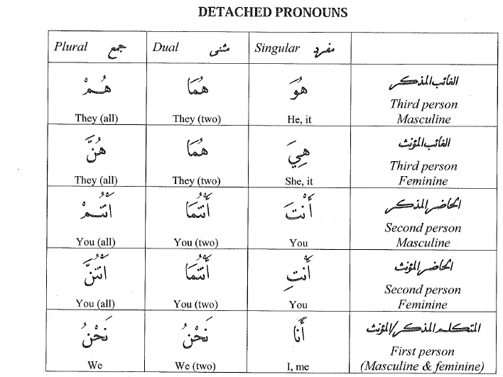
Detached Pronoun (Subject Pronoun)
I am a Muslim - أناْ مسلم
They two are Muslims - هما مسلمان
We are Muslims - نحن مسلمون
You (M) all are Muslims – أنتم مسلمون
She is a Muslim – هي مسلمة

Slide 29
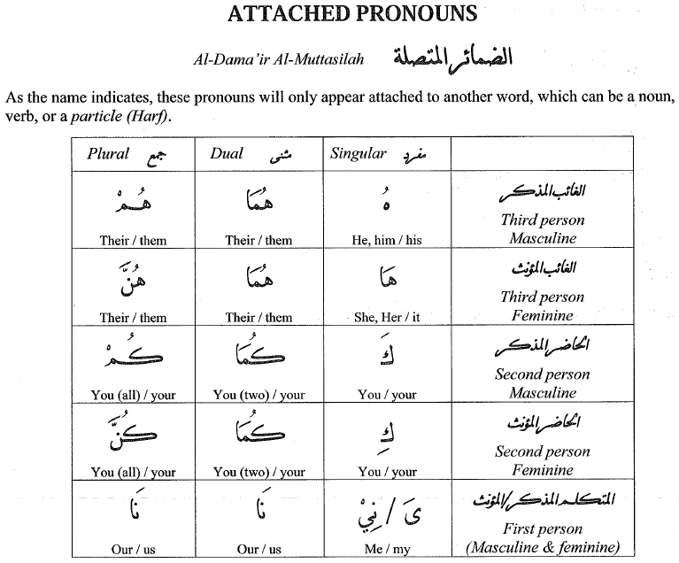
Pronoun

Slide 30
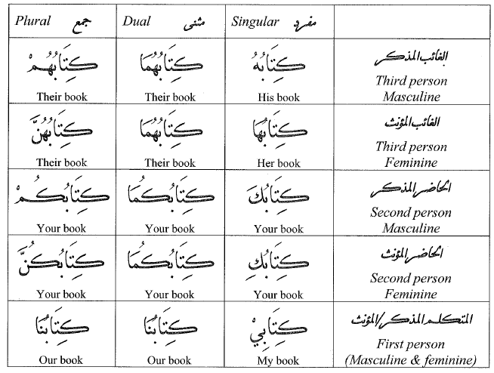
Attached Pronouns with Nouns (Possessive)

